Slide 1
Implementation of the Reverse/Adjoint Monte Carlo Method into Geant4
L. Desorgher, SpaceIT GmbH
F. Lei, Aerospace Division, QinetiQ
G. Santin, Space Environments and Effects Section, ESA/ESTEC

Slide 2
Backwards Integration Method
The phase space coordinates (position, direction, and energy) of a particle arriving at the detector are sampled at random.
Weight factors are used when one of several possible interactions must be selected at random.
The source distribution at the originating source and the particle weight are then combined to give the correct flux at the detector.
Notes:
Fokker-Planck Terms

Slide 3
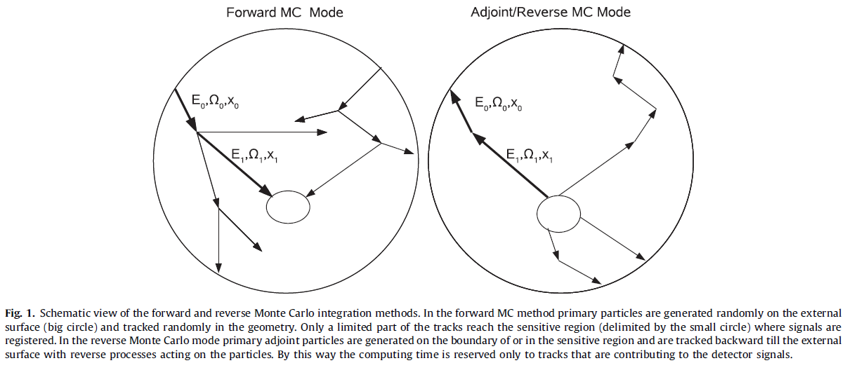
Simple Forward-Adjoint Example
How would bold particle track be implemented?

Slide 4


Forward Monte Carlo Integration
Probability primary particle i (E₀ Ω₀) travels x_{o} then produces particle j (E₁ Ω₁).
Probability primary particle j (E₁ Ω₁) travels x₁ without interaction.

Slide 5
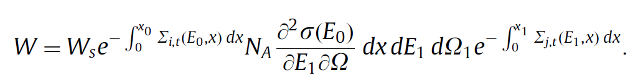

Forward Particle Weight
The normalized weight of the bold track is then given by
Where W_{s} is the weight of the primary particle
Where f(E₀ Ω₀) is the differential directional flux of the primary source.

Slide 6
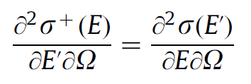

Adjoint Monte Carlo Integration
Adjoint Cross Sections
The forward and adjoint double differential cross sections are equivalent with initial and final energy switched.
Following the forward process the adjoint weight will be

Slide 7
Adjoint Monte Carlo Integration
Adjoint Cross Sections
The forward and adjoint double differential cross sections are equivalent with initial and final energy switched.
Following the forward process the adjoint weight will be

Slide 8

Adjoint Particle Weight
W_{n} is the normalization factor to the external flux which is the differential directional flux, f(E₀ Ω₀)
W_{d} is the weight correction associated with sampling of the adjoint primaries on the detector surface
Dependent on particle spectrum at detector surface, which is unknown without running the forward model.
For the spectrum, I(E), bias with a 1/E spectrum to reduce variance
Uniform position distribution
Cosine law distribution for angle

Slide 9
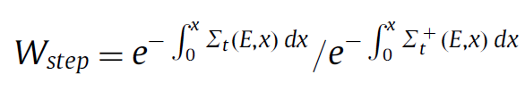

Adjoint Weight Correction and Biasing
The probability for a particle to service over a step distance x should be the same for both adjoint and forward particles
To insure this, a weight correction is added after every step
Similarly, if the differential cross section is biased a weight correction must be added

Slide 10
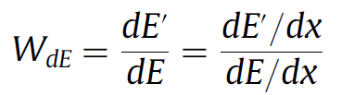
Charged Particles Continuous Energy Loss/Gain
In forward transport charged particles are continuously losing energy, this is accounted for by a net energy loss at each step
Similarly, in the adjoint transport charged particles are continuously gaining energy
Therefore, another weight correction has to be added

Slide 11
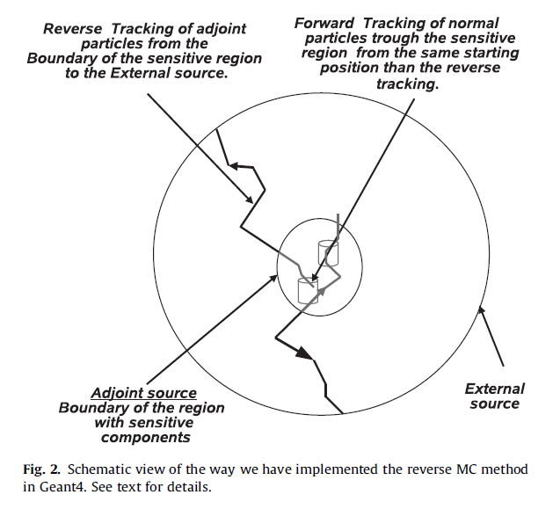
Implementation
How is the adjoint implemented in Geant4?

Slide 12
Implementation
A adjoint source region is selected with all sensitive structures inside
From the adjoint source to the external source adjoint transport is performed
Inside the adjoint source forward transport is performed
Allows for implementation within Geant4 with the list change of existing code

Slide 13
Questions?

